Slide 1
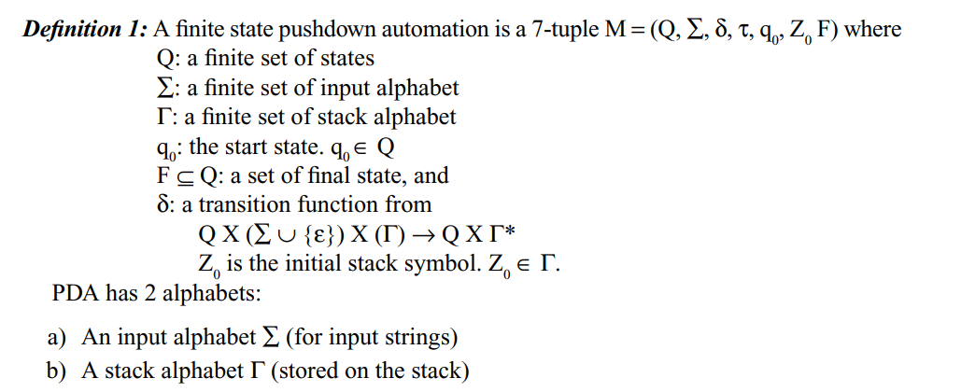
Push Down Automata (PDA)

Slide 2
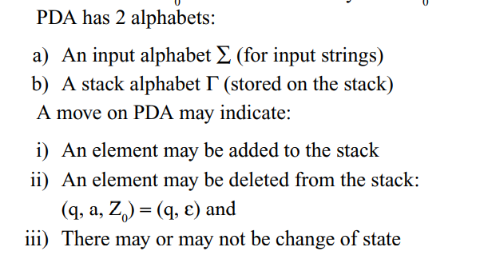
Push Down Automata (PDA)

Slide 3
Push Down Automata (PDA)
q- current state
a- current scan symbol
Z₀ – initial top of the stack

Slide 4
Instantaneous Description of PDA
Instantaneous Description (ID) is an informal notation of how a PDA “computes” a input string and make a decision that string is accepted or rejected.
A ID is a triple (q, w, α), where: 1. q is the current state. 2. w is the remaining input. 3.α is the stack contents, top at the left.
Ex:
1. ID =(q,aabb, Z)
(q is the current state, input string=aabb, current head position at first symbol ‘a’, stack consists of initial top symbol Z)

Slide 5
Language Accepted by PDA
A language can be accepted by a PDA using two approaches:
1. Acceptance by final state:
The PDA accepts its input by consuming it and finally it enters the final state.
2. Acceptance by empty stack:
On reading the input string from the initial configuration for some PDA, the stack of PDA becomes empty

Slide 6
Language Accepted by PDA

Slide 7
Language Accepted by PDA

Slide 8
Language Accepted by PDA

Slide 9
Language Accepted by PDA

Slide 10
Language Accepted by PDA

Slide 11
Language Accepted by PDA

Slide 12
Language Accepted by PDA

Slide 13
Language Accepted by PDA

Slide 14
Language Accepted by PDA

Slide 15
Language Accepted by PDA
A language can be accepted by a PDA using two approaches:
1. Acceptance by final state:
The PDA accepts its input by consuming it and finally it enters the final state.
2. Acceptance by empty stack:
On reading the input string from the initial configuration for some PDA, the stack of PDA becomes empty

Slide 16
PDA accepted by Empty stack (Example)
(q,aaabbb, Z)
(q is the current state, string=aabb, current head position at first symbol ‘a’, stack consists of initial top symbol Z)
├ move symbol
(q,aaabbb, Z) ├ (q,aabbb, aZ) ├ (q,abbb, aaZ) ├ (q,bbb, aaaZ) ├ (q1,bb, aaZ) ├ (q1,b, aZ) ├ (q1, є, Z) ├ (q1, є, є)
Sample PDA rules
δ (q,a,Z)=(q,aZ)
δ (q,a,a)=(q,aa)
δ (q,b,a)=(q1, є)
δ (q1,b,a)=(q1, є)
δ (q1, є,Z)=(q1, є)

Slide 17
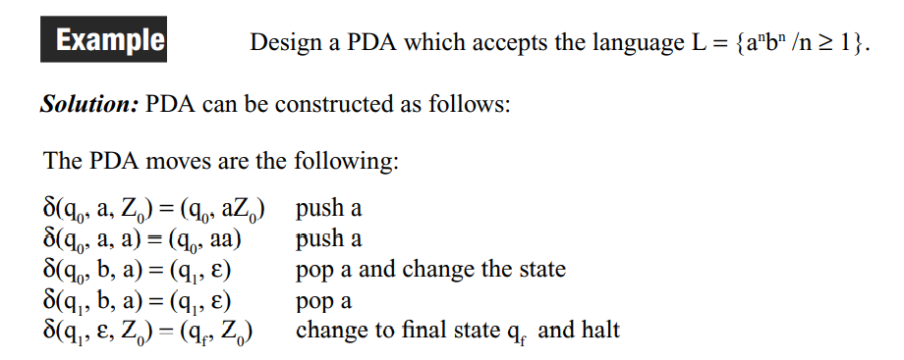
Example of PDA

Slide 18
Example of PDA

Slide 19
Example of PDA

Slide 20
Example of PDA

Slide 21
Example of PDA

Slide 22
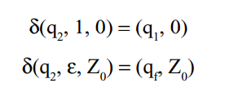
Example of PDA

Slide 23
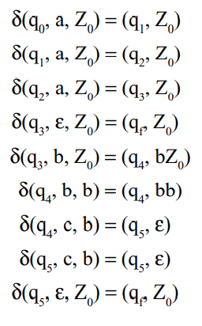
Example of PDA

Slide 24
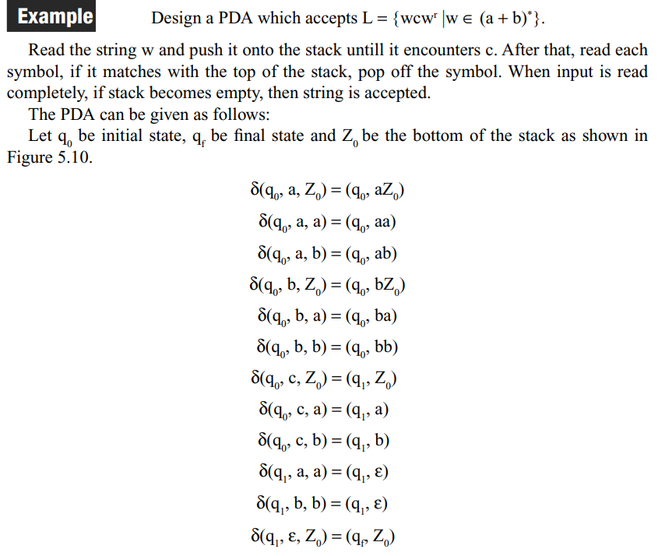
Example of PDA

Slide 25
PDA and CFL

Slide 26
PDA and CFL

Slide 27
PDA and CFL

Slide 28
Parse Tree or Derivation Tree Construction
Derivation tree is a graphical representation for the derivation of the given production rules for a given CFG.
It is the simple way to show how the derivation can be done to obtain some string from a given set of production rules. The derivation tree is also called a parse tree.

Slide 29
Ambiguous Grammars
A CFG is said to ambiguous if there exists more than one derivation tree for the given input string
i.e., more than one Left Most Derivation Tree (LMDT) or Right Most Derivation Tree (RMDT)

Slide 30
Ambiguous Grammars: Example
More than LMDs for the string id+id*id , Thus this Grammar is Ambiguous

Slide 31
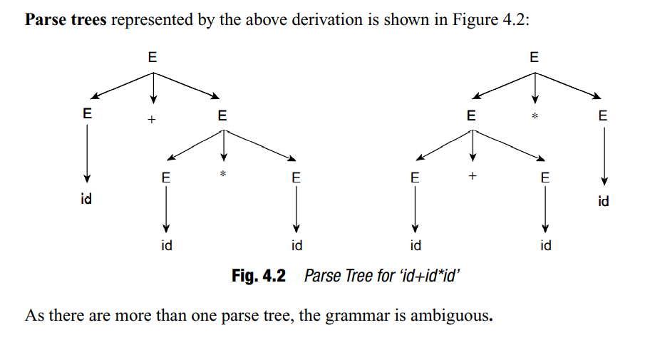
Ambiguous Grammars: Example
More than one parse trees for the string id+id*id , Thus this Grammar is Ambiguous

Slide 32
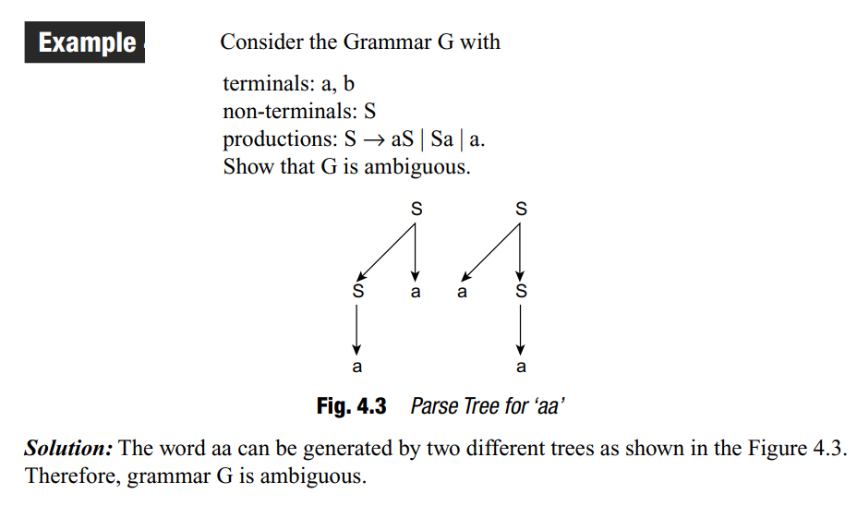
Ambiguous Grammars: Example
More than one parse trees for the string aa, Thus this Grammar is Ambiguous

Slide 33
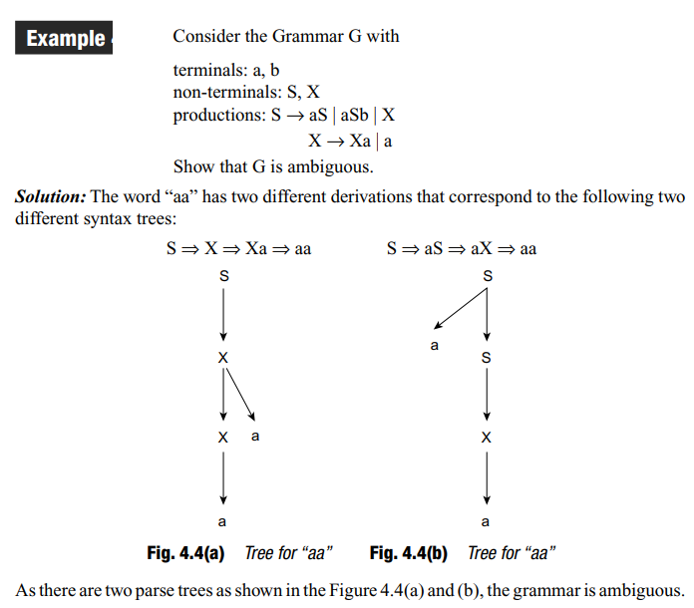
Ambiguous Grammars: Example
More than one parse trees for the string aa, Thus this Grammar is Ambiguous

Slide 34
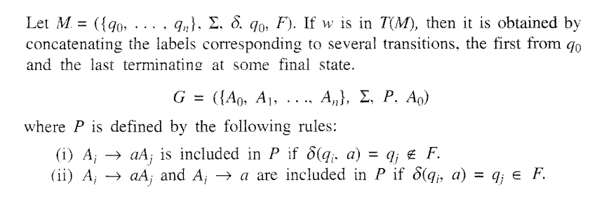
Construction of Regular Grammar T(M) Generating for a Given DFA

Slide 35
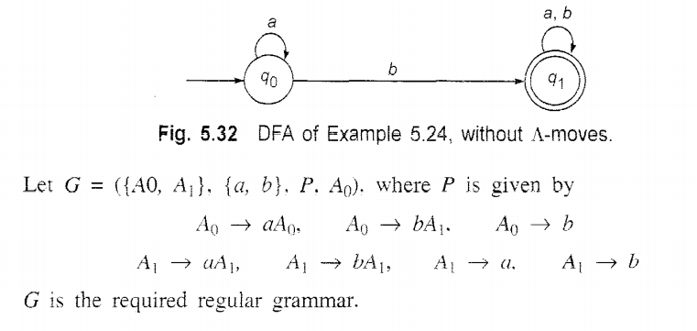
Construction of Regular Grammar T(M) Generating for a Given DFA: Example

Slide 36
Constructing a FA (Finite Automata) for given Regular Grammar (RG)
Finite Automata M = ({q0,q1,qf}, {a,b},δ, qo, {qf})

